Slide 1
Effects on the probability of having brown fat.
Group 1
STAC51 Case Study

Slide 2
Introduction
Context of the research:
Brown Fat Data set
Question of interest:
What conditions affect the presence of brown fat in humans?
Statistical procedures:
Generalized linear model, goodness of fit test based on deviance, step functions, LRT

Slide 3
Graphs and Summary
Statistics
Variables:
Y - Brown Fat (0,1) or Total_Vol - volume of brown fat
X - can be some or one of the 20 variables given in the case study
We start by visualizing the presence of brown fat in different cancer types.

Slide 4
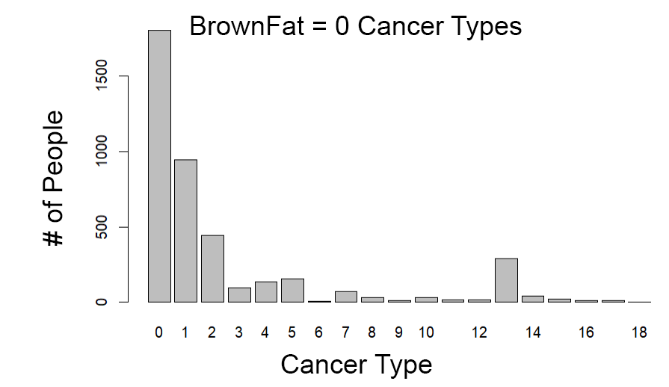
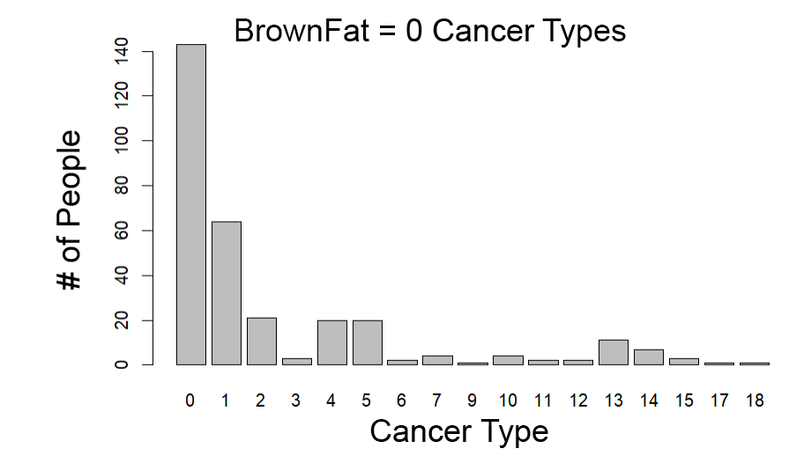
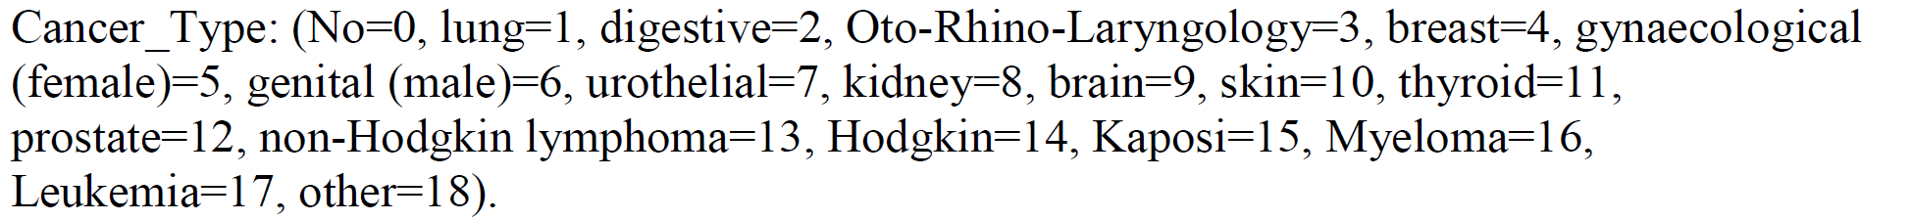
Presence of Brown Fat in different Cancer Types

Slide 5
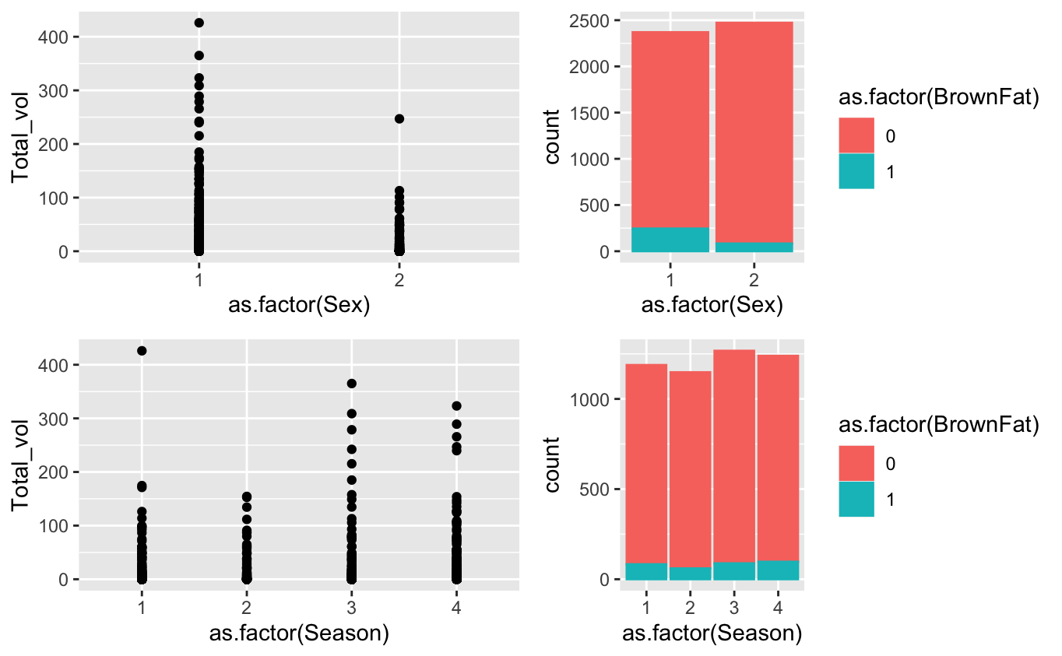
Two examples of other categorical variables
Sex
Female = 1
Male = 2
There seems to be slightly more female with BrownFat = 1.
Season
Spring=1
Summer=2
Autumn=3
Winter=4

Slide 6
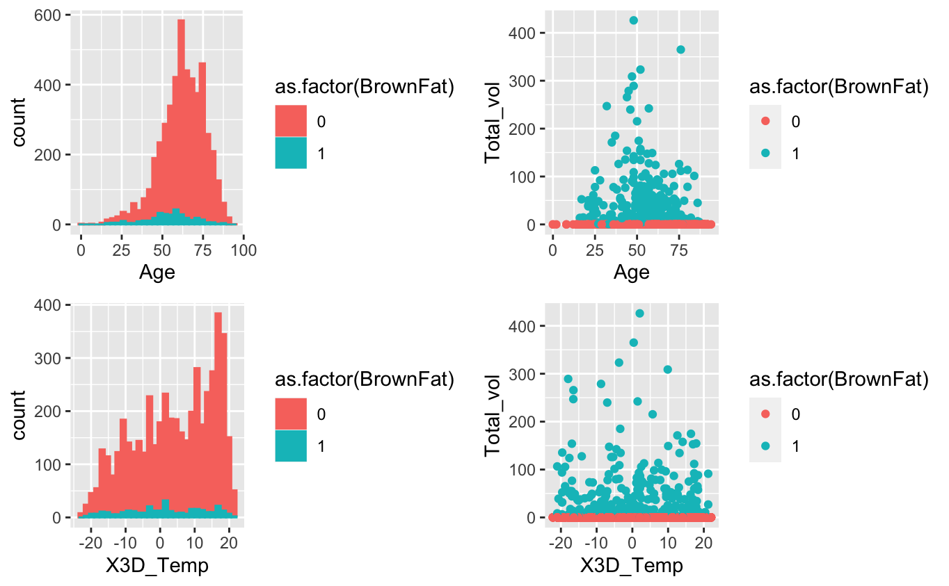
Two examples of numerical variables
Age
The distribution of Age with BrownFat = 0 is more right-skewed while the distribution of Age with BrownFat = 1 is more normal.
3D_Temp
The distribution of Average temperature of last 3 days with BrownFat = 0 is more right-skewed while those with BrownFat = 1 is more uniform.

Slide 7
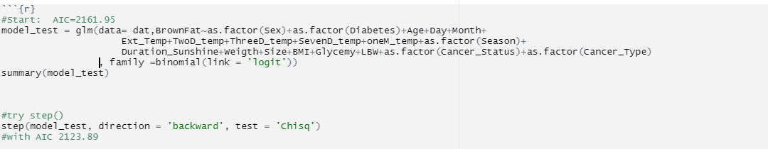
Analysis
Step 1: Use logit binomial glm() with all variables and use step() to reduce AIC
- AIC = 2123.89
- Get 5 most significant variables

Slide 8
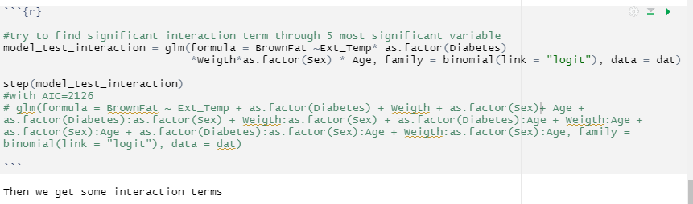
Analysis
Step 2: Try to find some useful interaction terms by step() 5 variables in step 1

Slide 9
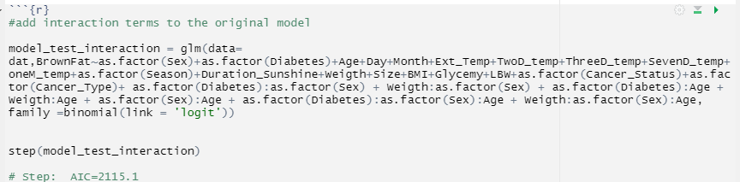
Analysis
Step 3: glm() all variables and interaction terms we found and step()
AIC = 2115.1 (decreased by 8)

Slide 10
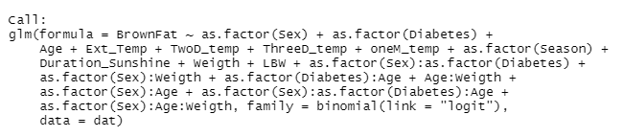
Final model

Slide 11
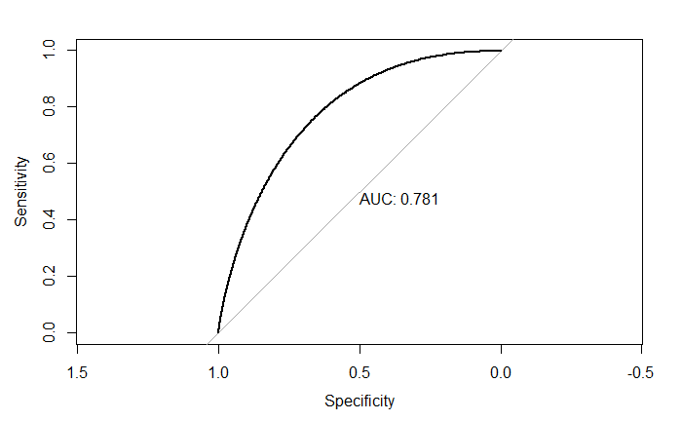
Conclusion
Lets say we take two data points belonging to separate classes then there is 78% chance model would be able to segregate them correctly.

Slide 12
The End.
Thanks for listening.

